Slide 1
Reading skills
Dr. T. Sunand Emmanuel

Slide 2
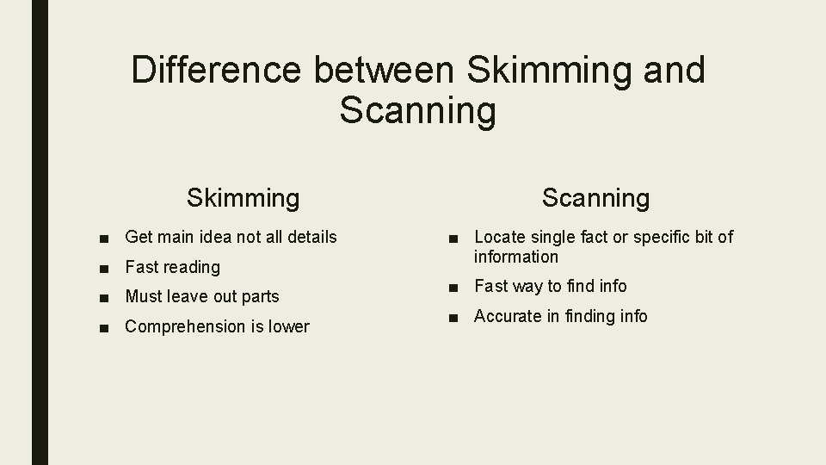
Skimming and scanning

Slide 3
Skimming and scanning
Skimming---- Reading for overall idea/gist. A bird’s eye view of the passage.
Scanning--- Reading for specific information in a passage (dates, names, meanings of particular words)

Slide 4
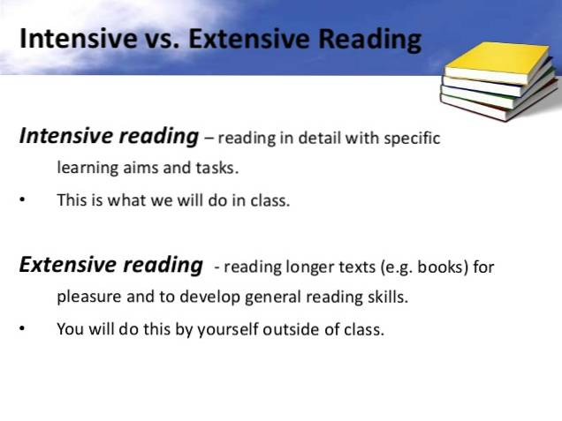
Intensive and extensive reading

Slide 5
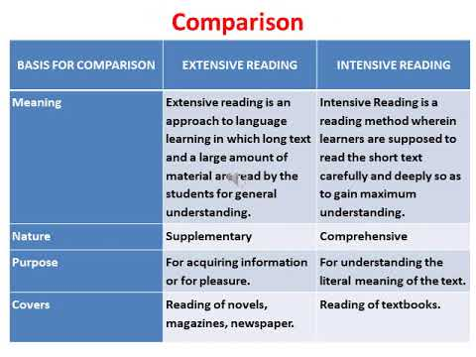

Slide 6
Global and local comprehension
Global comprehension: It is associated with extensive reading (reading for pleasure…novels, short stories).
Local comprehension: It is associated with intensive reading. (textbooks, journals, serious reading material.

Slide 7
https://www.google.co.in/search?q=skimming+and+sc
https://en.differbetween.com/article/differ

